Slide 1
Navigating to an Adult Medical Home: Transitioning from the Pediatric Medical World
Claire Lenker
UAB Pediatric Pulmonary Center

Slide 2
Objectives
At the conclusion of the presentation, participants will be able to:
  Identify critical steps to transition for CYSHCN
  Identify barriers to transition for CYSHCN

Slide 3
What we’ll cover
Background/importance
Literature
  Consensus statements
  Algorithms
Data:
  State performance
  NS-CSHCN
What does this look and feel like in real life?

Slide 4
Who are the CYSHCN?
“Children with special health care needs are those who have or are at an increased risk for a chronic physical, developmental, behavioral, or emotional condition who also require health and related services of a type or amount beyond that required by children generally.”
  MCHB, DSCSHN, 1998
Notes:
Universally accepted definition of CYSHCN

Slide 5
What is Transition?
Transition is “the purposeful, planned movement of adolescents and young adults with chronic physical and medical conditions from child-centered to adult-oriented healthcare system” (Reiss, 2002)
Transfer refers to single act of moving from one facility to another with no preparation or planning ahead of time.
Notes:
Transition is a process that can expand over years, transfer is a single act.
Story about Ricky Nuss in the Emergency Department on my first day

Slide 6
What’s Different??
Cystic Fibrosis
Spina Bifida
Muscular Dystrophies (DMD)
Neurological/metabolic conditions (PKU)
Congenital Heart Diseases
Orthopedic conditions (CP, rare congenital anomalies)
Asthma
Hemoglobinopathies (SC disease)
Diabetes
Sensory impairments (visual, hearing)
SCI/TBI/traumatic injuries
Psychiatric conditions
Notes:
Left column: diseases that are commonly treated in adult hood as well as childhood
Right column: diseases that until recently were considered only pediatric problems

Slide 7
What’s Different??
Asthma
Hemoglobinopathies (SC disease)
Diabetes
Sensory impairments (visual, hearing)
SCI/TBI/traumatic injuries
Psychiatric conditions
Conditions traditionally seen in both pediatric and adult settings
Cystic Fibrosis
Spina Bifida
Muscular Dystrophies (DMD)
Neurological/metabolic conditions (PKU)
Congenital Heart Diseases
Orthopedic conditions (CP, rare congenital anomalies)
Conditions found ONLY in pediatric settings…
until recently

Slide 8
Why is Transition Important?
Apx. 500,000 YSHCN reach their 18th birthday every year
A child born today with special health care needs has a 90% chance of living to adulthood (Reiss and Gibson, 2002)
Priority of federal government
The “EI” generation:
  PL94-141, PL99-457, PL101-479
Quality of care/Risk-appropriate
care issue
Notes:
YSHCN are moving into adult systems
PL 94-142 Education for All Handicapped Children Act (1975) –FAPE
PL 99-457 Education of the Handicapped Act Amendments (1986) EI amendments; ages 3-5
PL 101-476 Individuals with Disabilities Education Act (IDEA) (1990) –reaffirmed and incl. transition plan by age 16

Slide 9
Why is this important in Alabama?
17.8% of children in Alabama have special health care needs:
  Alabama is home to 200,367 CSHCN
  Apx. 73,968 are YSCHN ages 12-17
Source: 2009/2010 NSCSHCN, www.childhealthdata.org

Slide 10


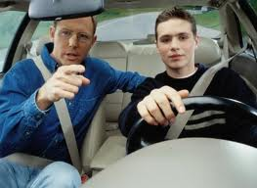
Why is preparing important?
Change is hard!
Being prepared helps
Preparing takes a long time
Every youth (including YSHCN) should receive care that is:
  Respectful of autonomy
  Developmentally appropriate
  Mindful of promoting maximum potential
Notes:
Analogies to driving, working, dating, etc.

Slide 11
2 Important Articles:
2002: Consensus Statement on Health Care Transitions for Young Adults with Special Health Care Needs - AAP, AAFP, ACP-American Society of Internal Medicine
2011: Clinical Report – Supporting the Health Care Transition from Adolescence to Adulthood in the Medical Home – AAP, AAFP, ACP

Slide 12
2002 Consensus Statement:
“6 Critical Steps” in Transition
Identify health care provider to coordinate transition
Identify core knowledge and skills
  Encounter checklists (too many to count)
  Outcome lists (too many to count)
  Teaching tools
  Policies, assent forms, etc.
Prepare and maintain concise medical record
Notes:
Checklists and teaching tools:
Age appropriate skills
Analogies of driving, dating, working, etc.
Examples of doing:
signing in, making own appointments, carrying and presenting insurance cards, calling for refills
Examples of participating:
Teaching physical exam, recognizing signs of illness, going in alone, preparing questions

Slide 13
“6 Critical Steps” in Transition
Written transition plan by age 14
  Review and update annually
Apply preventive screening guidelines
  Prevent secondary complications
  Sexuality, aging, exercise, nutrition, MH
Ensure affordable, continuous health insurance coverage
Notes:
Brett: talk about financial implications of disability

Slide 14
2011 Clinical Report: 6 Core Elements of Health Care Transition
Pediatric Setting
Adult Setting
Transition Policy
“Transitioning Youth “ Registry
Transition Preparation
Transition Planning
  HCT Action Plan
  Portable medical summary
  Emergency care plan
Transition and Transfer of Care
Transition Completion
Young Adult Privacy and Consent Policy
Young Adult Patient Registry
Transition Preparation
Transition Planning
  HCT Action Plan
  Portable medical summary
  Emergency care plan
Transition and Transfer of Care
Transition Completion
Notes:
See handout
This statement is really directed at Primary Care providers in a Medical Home.

Slide 15
Family-to-Family Health Info Center Project Resources to help you get optimal medical care & be a better advocate
Recommendations of Agency for Healthcare Research and Quality (AHRQ)
    Start with open communication.
    Mind your medications.
    Share history of allergies/reactions to medicines or treatments.
    Ask your doctor to write instructions clearly.

Slide 16
Use our Health Care Notebook to keep ongoing record of health care history + current medical status.
How can you get one?
    Ask your facilitator for request form – NOW
    Summit on Apr. 16 & 17 Marriott Legends at Capitol Hill in Prattville
    Online request at
    http://www.familyvoicesal.org/requestInfo/
    Download (entire book or single pages) http://www.familyvoicesal.org/resources-frm-CareNotebook.php
      ** keep electronic back up on USB flash drive

Slide 17
  Care Notebook: Organize/modify for you!
    Family Information
    Emergency Info = portable medical summary
    Physician & Provider Contacts (business card sheet)
    Record of Medical Care (CD/DVD sheet)
    Personal Notes & Planning (keep receipts for taxes)
  Start with your next visit & stay current
  Ask for reports, records & e-copy at visit
  Transfer hospitalizations + surgeries
  Other resources including Summit Apr. 16 & 17

Slide 18
2011 Clinical Report: Readiness
Provider readiness:
  Explicit office policies
  Receive training and TA
  ↑ capacity for adult providers
Family readiness:
  Ongoing education
  Normalize transition process
Youth readiness
  Driver in the process
  Foster self-management skills
  Prioritizing and valuing independence
Notes:
Patients ready to speak up; parents ready to let go
Paradigm shift; let pt discover implications for themselves.

Slide 19

2011 Clinical Report: Algorithm
Medical Home:
  Preventive Care
  Acute Illness Management
  Chronic Condition Management
“Rows”
  Medical home interaction
  Age ranges
  Action steps/specific age ranges
  Determination of special needs
  Chronic condition management and follow up
  Interaction complete

Slide 20
2011 Clinic Report: 4 Components of a Transition Plan
Assess for transition readiness
  Assess skills
  Set goals
Plan a dynamic and longitudinal process to accomplish realistic goals
  Written transition plan
Implement the plan through education of all involved parties and empowerment of the youth
Document progress to enable ongoing reassessment and movement of medical information to the receiving provider

Slide 21
2011 Clinical Report: Transition for CYSHCN
Registry
  Identified as having a special health care need
Care Plan
Care Coordination
CCM visits
Co-management – needs to be explicit
Components of a Transition Plan:
  Assessment of readiness
  Insurance information
  Self-advocacy
  Legal issues
  Health Education
  Caregiver issues

Slide 22
How Ready are Adult Providers?
Patel and O’Hare: looked at readiness among Peds and IM residents to care for 10 chronic conditions
Anonymous survey, N = 94 (30 Peds, 64 IM)
  Rec’d any education on transition:
    Peds = 73%, IM = 13.8%
  Peds > IM in comfort for all conditions except for asthma (no difference)
  Fewer significant differences in outpatient only
  Equal expectation for future practice with asthma, SC, sz disorder, fewer IMs expect to care for autism, CP, spina bifida
Patel and O’Hare, 2010

Slide 23
How Ready are Adult Providers?
Peter, et al 2009, random sample of internists
45-item survey, rate concerns
Female MDs scored significantly higher for:
  Diff involving parent w/o comp. youth indep.
  Patient lack of insurance
  Parental reluctance to relinquish control
Specialists rating > generalists (sig):
  Pediatrician is reluctant to ‘let go’ of patient
Some rural/urban and pvt/academic diff
Peter et al, 2009

Slide 24
Peter et al, 2009
Results coded into themes:
  Medical competency (skills)
  Family involvement
  Psychosocial needs
  System issues
  Maturity
  Transition coordination

Slide 25
Peter et al, 2009
Top 8 concerns overall:
  Internists may not have training in congenital and childhood chronic illnesses to manage pt.
  Difficult to care for pts with developmental disabilities if family does not stay involved
  Difficult to meet psychosocial needs
  Some patients need a “superspecialist”
  Internists lack training in adolescent dev/behavior
  Diff to face end-of-life issues
  Managed Care
  Families have high expectations for time/attention

Slide 26
What does the data tell us?
National Survey of Children with Special Health Care Needs (NS-CSHCN)
Administered in 2001, 2005/2006, 2009/2010
2009/2010, results just released:
  371,617 children screened; 40,242 detailed CSHCN interviews conducted
Minimum of households in each state to reach state sample of 750 CSHCN
English, Spanish, Mandarin, Cantonese, Vietnamese, Korean

Slide 27
Successful Transition?
Scal, 2005, transition more likely to be addressed from age 14-17:
  Older age
  Female gender
  ⬆ complexity of health care needs
  ⬆ quality of parent/doctor relationship
Parents report transition discussed: 50.2%
Discussed and developed a plan: 16.4%
Data from NS-CSHCN, 2001

Slide 28


Title Block Grant
National Performance Measure #6:
“The percentage of youth with special health care needs who received the services necessary to make transitions to all aspects of adult life.”
Notes:
NPM #6 is also one of the 6 goals for CYSHCN as a part of the implementation of HP 2010.

Slide 29
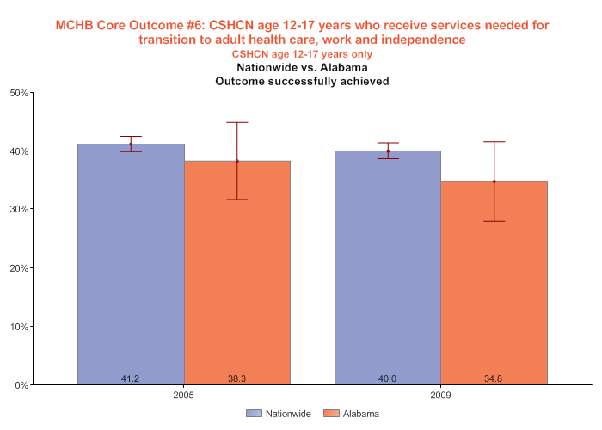
PM06, US v. AL

Slide 30
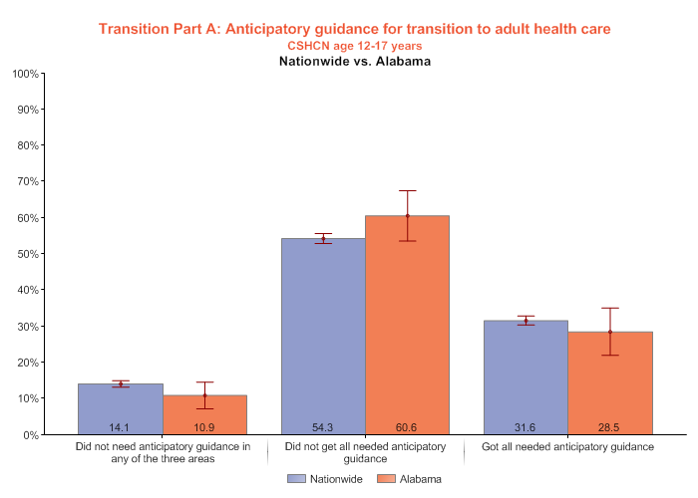
Rec’d anticipatory guidance
Notes:
Three areas are:

Slide 31
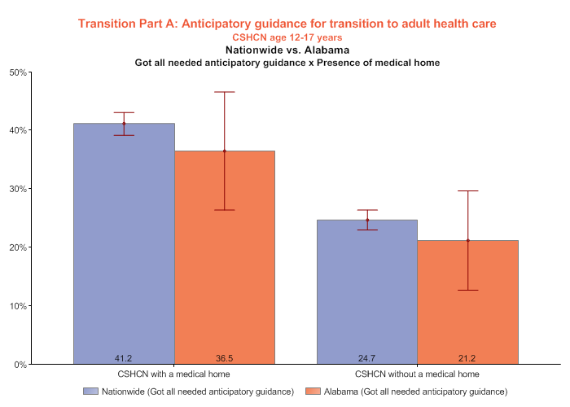
Rec’d Anticipatory Guidance, Medical Home

Slide 32
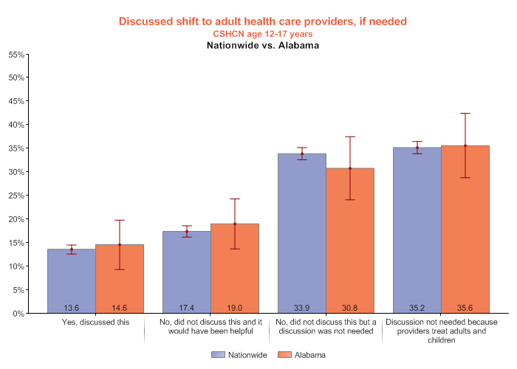
MD has discussed transition

Slide 33
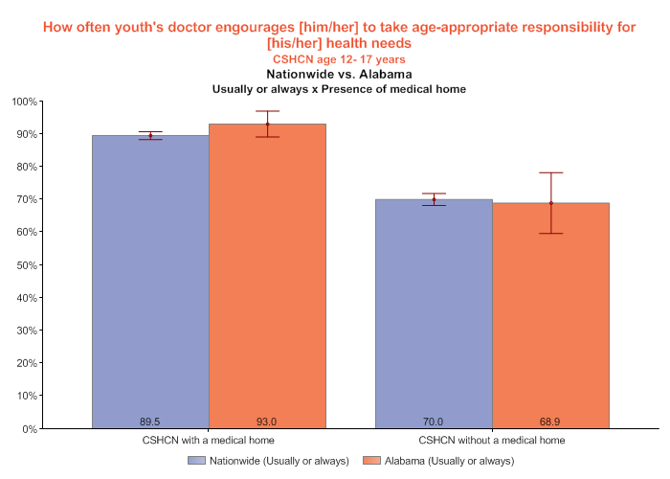
MD encourages self-mgmt skills

Slide 34
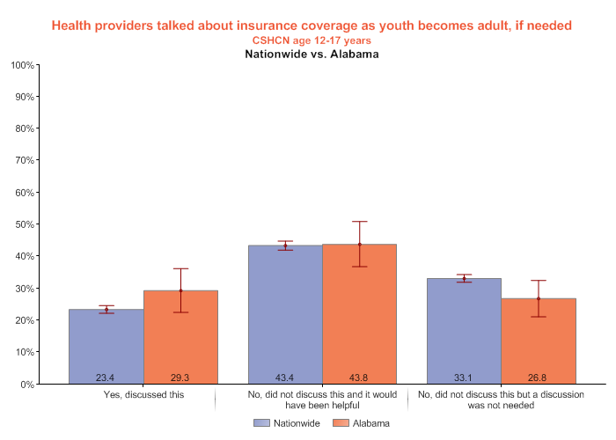
Discussed keeping insurance

Slide 35
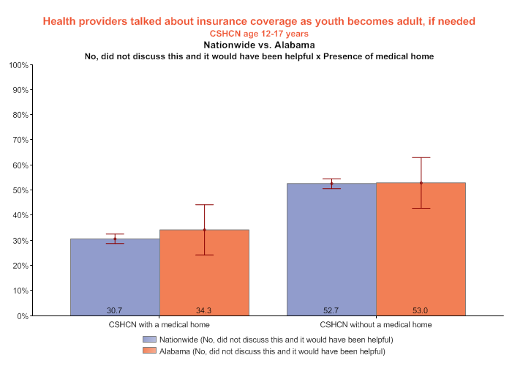
Did not discussed keeping insurance, +/- medical home

Slide 36
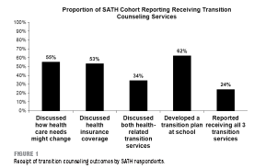
Survey of Adolescent Transition and Health, Sawicki, 2011
Follow up of 2001 cohort from NS-CSHCN
Sample more white, affluent, less medically complex
N = 1865
24% rec’d all 3 transition services
Notes:
Discussed how health care needs might change
Discussed health insurance coverage
Discussed both health-related transition services
Developed a transition plan at school
Reported receiving all 3 transition services.

Slide 37
State Performance on Transition
Analysis from the 2005/2006 NS-CSHCN
Sample size 16,876
Classified as high, medium, and low performance states
CSHCN who were:
  Hispanic, non-Hispanic Black, do not have a medical home or adequate insurance coverage
  …..were less likely to reside in a high-performance state
Kane DJ, Kasehgen L, Punyko J, Carle AC. What factors are associated with state performance on provision of transition services to CSHCN? Pediatrics, Nov 2009.

Slide 38
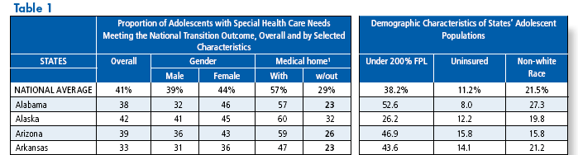
State Performance on Transition
McManus and Rodgers, 2011

Slide 39
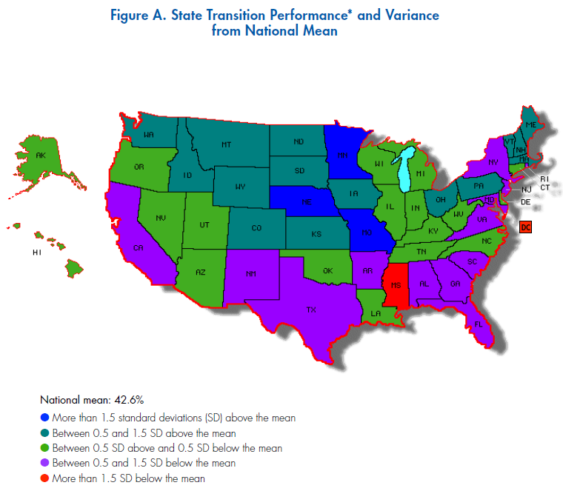

Slide 40
Models of Transition
Adult provider comes to pediatric setting
Pediatric provider goes to adult setting
Same MD, different team
Different MD, same team
CHECKLISTS

Slide 41
Pediatric to Adult Systems of Care: Possibilities
Family
Family to Family
KASA
Youth
Pediatric
PCP
Co-Management
Adult
PCP
Pediatric
Specialists
Medical
Dental
Behavioral
Adult
Specialists
Medical
Dental
Behavioral
Community Based Partners
Title V
Education
Vocation
Avocation
www.hrtw.org
Richard Antonelli, MD

Slide 42
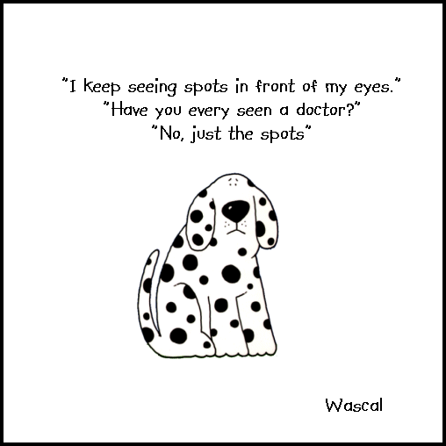
Synchronous v Asynchronous
What is the transition policy?
  Primary Care MD
  Subspecialty MDs
    Surgery
    Medical
  Hospital
  Private Payers
  Medicaid (EPSDT)
  CSHCN program
Notes:
Example of Vent dependent Spina Bifida patient
Primary care: pediatrician
Pulmonary, urology, neurosurgery, orthopedic, psychiatry, rehab, optho,
VIVA UAB’s policy

Slide 43
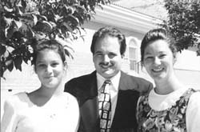
The Example of Cystic Fibrosis
Today adults (>18) account for about 45% of all patients with CF
In 2002 the CFF mandated that every center with 40 or more adults must establish an adult CF center and a transition program
Notes:
Parents were told at diagnosis not to expect pts to live beyond age _____
Resulted in a lack of expectations for an adult life (goals, education, independence)
Brett’s example of always being the same age as the life expectancy…..
We absolutely cannot tell parents today what their child’s life expectancy will be.
Bret: no, I don’t want to go play bingo, I don’t need any more pencil erasers

Slide 44
Patient Perspectives
Anticipation:
  “This is a reward for living so long”
  “No one knows me—a fresh start!”
Uncertainty:
  “Who will be my (nurse, social worker, etc.)”
  “Where will I park?”
Fear:
  “Those doctors don’t know me and what I’ve been through”
  “What if I don’t like it?” “Can I come back?”
Indifference:
  “What’s the big deal?”
Notes:
Details, logistics, etc. often just as important as medical care. Examples: parking, food service, overnight guests, etc.
Brett: critical v chronically ill; CoA as a second home; feeling rejected; will not ever bond with adult providers the same way

Slide 45
Parent Perspectives
Letting go/Feeling left out:
  “They want to treat my son/daughter like an adult but they are still MY CHILD”
  “I don’t want to be treated like a visitor”
  “I’ve worked so hard to keep my child well for so long and now they (child, adult team) will be careless”
Grief:
  “I’m sad to leave the providers who diagnosed my child and I’ve known for years”
  “Things will never be the same”
Threatened:
  “We had a good relationship with our old doctors and now someone who doesn’t know my child will change things.”
Notes:
Parents see child as not able to function independently
Child’s decisions may differ from parental decisions (ie, DNR status)
Competency and guardianship issues??

Slide 46
Pediatric System Perspectives
Arrogance:
  “They don’t know what they’re doing”
  “No one can take care of our patients as well as we can”
  “No one else understands the patients’ needs”
Fostering dependency or mistrust:
  “We don’t want to send you to the adult system but we have to”
  “Our patients have already lost so much, why put them through this, too?”
Grief:
  “I feel cheated to turn them over to someone else when they need me the most”
Relief:
  “They will get the adult care they really need”
Notes:
Enabling/Sabotage behaviors: continuing to take phone calls, call in scrips, etc.
“Those 21 year old girls flirt with you and worship you and it makes you feel special”—Melissa to Dr. B.

Slide 47
Adult System Perspectives
Resistance:
  “Why do we have to do this?”
  “We’re busy enough without something new”
Minimizing:
  “We don’t need any special training or a different system; how hard can it be?”
Blame:
  “Those pediatric people just foster dependency”
  “The patients are used to being catered to and are all spoiled—they are BRATS”
  “They need to stop meddling”
Notes:
Patients coming back to pediatric provider and telling horror stories.

Slide 48
The CoA/UAB Experience
Identifying adult providers
Educating adult CF team
Began with sickest adults
Exception for terminal patient not pursuing transplant
Exception for parent/child dyad
Med/Peds involvement
Joint clinic
Notes:
Was transitioning the sickest pts the wisest thing to do?
Am I a guinea pig?

Slide 49
Lessons Learned
Institutional buy-in is essential
Begin talking about transition at diagnosis
Encourage healthcare transitions throughout the child’s life
  Day care, school, high school→college, etc.
  Clinic alone and admit to adolescent unit at age 14
Team hygiene
  Communication, Communication……
Meet with each patient individually the year before their transition to go over the transition check list
PATIENT/FAMILY INVOLVEMENT AT A SYSTEM LEVEL!!
Notes:
Natural transitions – starting school, being seen in clinic alone at age 14, transition from high school to work or college, transition from pediatric to adolescent unit at age 14
Identity v. role confusion; clinic

Slide 50
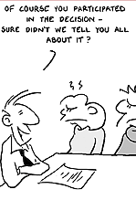

Slide 51
More Lessons Learned
A specific transition-focused clinic helps
Leadership of Adult CF Coordinator and physician proved to be a key factor
Inpatient floor staff and patients perceived as “family” (boundary issues, sabotage, enmeshment, grief issues)
Notes:
Brett: policy won’t help with emotional aspects of transition; be open to adapting for individuals

Slide 52
Transition Process – Sample Items
Initial letter informing patient and family of transition process and time line
Meet with patient and family to answer questions about transition process
Assess level of independence in all areas and encourage progression
Provide tour of hospital and outpatient clinic
Provide list of names and contact numbers for the adult team
Educate about hospital and clinic (i.e., how to make appointments, important telephone numbers, where to park, etc.)
Educate patient and family about requesting services from allied health staff
Provide adult team with appropriate medical records—hand delivered
“Graduation” book with warm wishes from pediatric provider team members

Slide 53
Barriers -- Summary
Systems problems
  Lack of adult providers
  Training deficits for adult providers
  Providers not fully committed
  Inadequate funding sources
Patient and family
  Patient and parents do not perceive the need for transition
  Severity of illness/complexity
  Level of maturity of patient
  Family stressors or lack of family support

Slide 54

In Alabama…..
CRS: Teen Transition Clinic
  D70 Grant
VRS:
  Assessment/Evaluation Services
  Transition Counselors
Alabama Work Incentives Network
(ALA-WIN)
  Joint effort of ILRGB, ADAP, UCP, ADRS
Notes:
Independent Living Resources of Greater Bham

Slide 55
Take Home Messages
Transition affects:
  CYSHCN and their families
  Pediatric providers
  Adult providers
Planning for transition should begin at diagnosis
There is no ONE CORRECT way to transition
“Every transition is unique—just like you”
— Mallory Cyr

Slide 56


Web Sites
Healthy and Ready to Work (former MCHB funding) www.hrtw.org
Got Transition? (current MCHB funding) www.gottransition.org
Tools, i.e. readiness indices and checklists
Articles and references
Broadcasts

Slide 57

Web sites, cont.
National Center for Medical Home Implementation – Medical Homes @ Work
e-newsletter, inaugural supplement, Spotlight on Child Health Issues series, October 2011, Transitioning From a Pediatric to an Adult Medical Home.
http://www.medicalhomeinfo.org/about/
newsletter/spotlight_issues/transitions.aspx

Slide 58
QUESTIONS???

